Slide 1
The World Inside A Computer
The Parts of the Computer Cabinet
Hrithik Shah 7G
Monday, February 25, 2013

Slide 2
Table Of Contents
Computer Hardware (Slides 3 to 8)
CPU (Slide 4)
Hard Drive (Slide 5)
Video Card (Slide 6)
Sound Card (Slide 7)
RAM (Slide 8)
Computer Accessories (Slides 9 to 11)
Webcam (Slide 10)
Keyboard (Slide 11)
Laptop Battery (Slide 12)
Ending Slide

Slide 3
Computer Hardware
The hardware of a computer is made up of many things. There are tiny parts like the CPU and big parts like the Hard Drive. In the next few slides, you will get to learn about some of the parts of the computer hardware.
Table of Contents

Slide 4
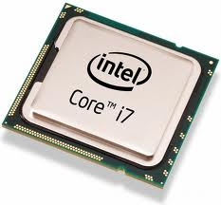
CPU(Central Processing Unit)
The CPU is a small square-shaped chip that has tiny pins that connect to the motherboard. The CPU is the chip that processes all your information and has a faster processing speed if the CPU is new.
I have chosen the Intel Pentium processor as the best CPU for the school, since our school doesn’t need a fast processor. We basically use the computers at school to do school work. You don’t need a fast processor for that. Most of the students also bring in their own personal devices to work on and most of the students like doing many assigned projects at home since they have the newer versions of Microsoft Office.
Table of Contents

Slide 5
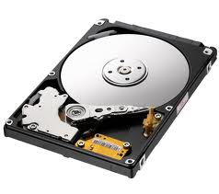
Hard Drive
The Hard Drive, a big rectangular box, stores all the information of your computer. It also loads the operating system such as Windows XP. Inside the box there is a disk that can be capable to spin at an incredible 7000 rpm.
I chose the Seagate Barracuda 1TB because these drives with the TB have advanced power modes to save more energy without losing performance. I thought we should use this because the hard drive saves energy which would be good since we use hard drives that use a lot of electricity. The hard drive is also 70% or more recyclable because the materials used to make the hard drive are recyclable.
Table of Contents

Slide 6
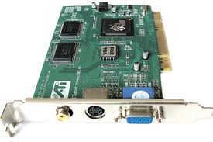
Video Card
The Video card also known as the graphics card, looks like a big circuit box and depending on the video card, it can also have a fan.
I chose the Sapphire Radeon HD 5450 because it is a good video card that would show normal videos. It isn’t capable of displaying video games with a lot of graphics. It is ideal for the computers at school since we don’t play video games at school.
Table of Contents

Slide 7
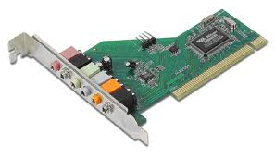
Sound Card
The Sound Card is a small chip that usually has two imports- one for headphones and the other for microphones. It lets you listen to your favourite music through the speakers of the computer.
I think the Creative Labs Audigy SE Sound Board is a great sound card for our school because it makes the sound of the videos we watch in class crisp and clear. It really is a whole new world with music that you enjoy. When we were doing our book trailers for Media Literacy, the music wasn’t that clear and I thought that if we had a better sound card then the trailer would be ever so appealing.
Table of Contents

Slide 8
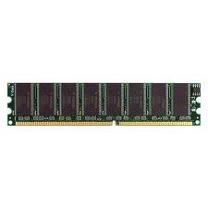
RAM
The Random Access Memory is a storage that stores all any applications such as the one you are reading right now.
The Crucial 512MB PC3200 is the best RAM for the school because it has a good amount of storage. We would not need a lot of storage because we don’t use the computers a lot. Over the following years, we might need RAMs with bigger storages because we might start using the computers a lot, since the school is soon going to be a technology friendly environment. But right now, this RAM is just right.
Table of Contents

Slide 9
Computer Accessories
The accessories of a computer make it easier to use the computer. Some accessories are very important and some the computer and be used without. I have chosen two accessories that I think are very useful and that I think that is necessary in all computers.
Table of Contents

Slide 10
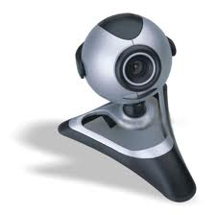
Webcam
A Webcam is a simple camera that takes many pictures at an incredible speed and sends it to the other user. It has three main parts, the digital camera, a computer and a wire connecting the two.
In our school, there aren’t any webcams. I think a webcam would be great for every computer or at least one computer in the classroom to have a webcam. With a webcam, we could do many things. We can have a video conference with the teacher if he or she is not there that day. We can also use the webcam so that a student who has gone for a vacation can still participate in class and not miss school. Furthermore, if we have want to learn from or hear from one of the CEOs of a leading industry we can talk to them without them having to come from to our school.
Table of Contents

Slide 11
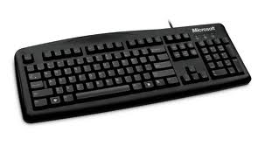
Keyboard
The Keyboard is the most important accessory for the computer in my perspective. It’s the next generation of the typewriter. I think it’s even more important than the mouse because you can use the computer without having to use your mouse, but you can’t use the computer without having to use the keyboard.
I have chosen this Logitech Wireless Touch Keyboard because this keyboard comes with a mouse so the school won’t have to buy anymore computer mice. This keyboard is also wireless so there won’t be any tangled wires. The teacher can also teach without having to be at the computer all the time if teaching using the computer.
Table of Contents

Slide 12
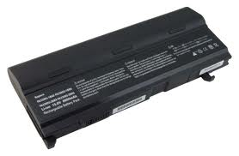
Laptop Battery
Sometimes the battery of your computer loses the ability to save power for your computer. This happens when your computer battery is old. The battery cannot hold the charge and the battery life is all of a sudden 20 minutes from 1 hour. To save your battery power you should try dimming the brightness of your screen, try to keep the ventilation system open so your computer stays cool and don't let it be the sun's exposure because it makes the battery very hot.
Table of Contents

Slide 13
Thank You For Your Time! I hope you enjoyed my presentation of the Computer.

